Slide 1
JDBC
Java Database Connectivity

Slide 2
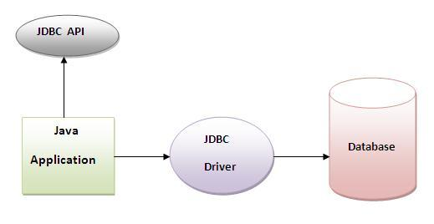
JDBC Architecture

Slide 3
Why use JDBC
Before JDBC, ODBC API was the database API to connect and execute query with the database. But, ODBC API uses ODBC driver which is written in C language (i.e. platform dependent and unsecured).
That is why Java has defined its own API (JDBC API) that uses JDBC drivers (written in Java language).

Slide 4
What is API?
API (Application programming interface) is a document that contains description of all the features of a product or software.
It represents classes and interfaces that software programs can follow to communicate with each other. An API can be created for applications, libraries, operating systems, etc

Slide 5
JDBC Packages
java.sql
Javax.sql

Slide 6
JDBC Driver
JDBC Driver is a software component that enables java application to interact with the database.

Slide 7
Types of JDBC Drivers
1. JDBC-ODBC bridge driver
2. Native-API driver (partially java driver)
3. Network Protocol driver (fully java driver)
4. Thin driver (fully java driver)

Slide 8
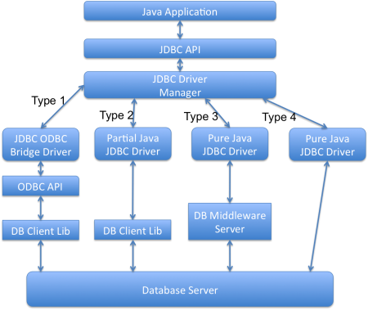
Image source: journaldev.com

Slide 9
1) JDBC-ODBC bridge driver
The JDBC-ODBC bridge driver uses ODBC driver to connect to the database. The JDBC-ODBC bridge driver converts JDBC method calls into the ODBC function calls.

Slide 10
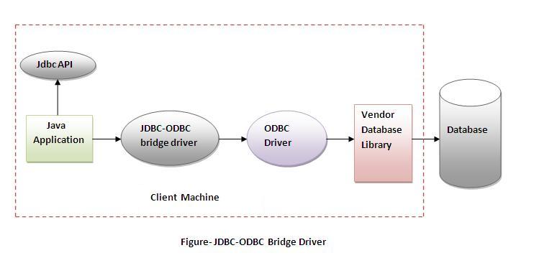
JDBC-ODBC Driver Architecture

Slide 11
Advantages:
easy to use.
can be easily connected to any database.

Slide 12
Disadvantages:
Performance degraded because JDBC method call is converted into the ODBC function calls.
The ODBC driver needs to be installed on the client machine.

Slide 13
2) Native-API driver
The Native API driver uses the client-side libraries of the database. The driver converts JDBC method calls into native calls of the database API. It is not written entirely in java

Slide 14
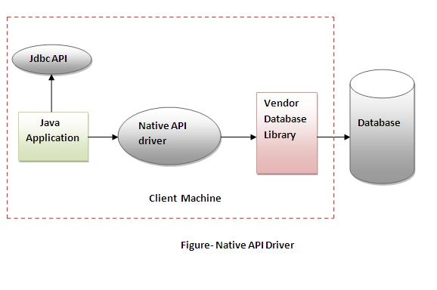
Native API Driver Architecture

Slide 15
Advantage:
performance upgraded than JDBC-ODBC bridge driver.

Slide 16
Disadvantage:
The Native driver needs to be installed on the each client machine.
The Vendor client library needs to be installed on client machine.

Slide 17
3) Network Protocol driver
The Network Protocol driver uses middleware (application server) that converts JDBC calls directly or indirectly into the vendor-specific database protocol. It is fully written in java

Slide 18
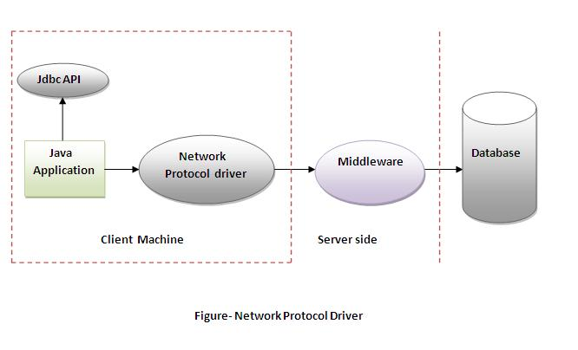
Network Protocol Driver - Architecture

Slide 19
Advantage:
No client side library is required because of application server that can perform many tasks like auditing, load balancing, logging etc.

Slide 20
Disadvantage:
Network support is required on client machine.
Requires database-specific coding to be done in the middle tier.
Maintenance of Network Protocol driver becomes costly because it requires database-specific coding to be done in the middle tier.

Slide 21
4) Thin driver
The thin driver converts JDBC calls directly into the vendor-specific database protocol. That is why it is known as thin driver. It is fully written in Java language.

Slide 22
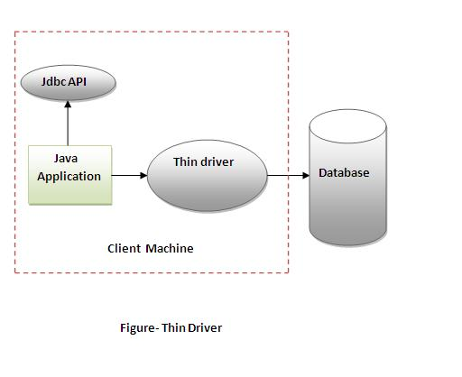
Thin – Driver Architecture

Slide 23
Advantage:
Better performance than all other drivers.
No software is required at client side or server side.

Slide 24
Disadvantage
Drivers depends on the Database.

Slide 25
Steps to create a JDBC Application

Slide 26
5 steps to connect any java application with the database in java using JDBC
Register the driver class
Creating connection
Creating statement
Executing queries
Closing connection

Slide 27
1) Register the driver class
The forName() method of Class class is used to register the driver class. This method is used to dynamically load the driver class

Slide 28
Syntax of forName() method
public static void forName(String className)throws ClassNotFoundException

Slide 29
Example to register the OracleDriver class
Class.forName("oracle.jdbc.driver.OracleDriver");

Slide 30
2) Create the connection object
The getConnection() method of DriverManager class is used to establish connection with the database.

Slide 31
Syntax of getConnection() method
1) public static Connection getConnection(String url)throws SQLException
2) public static Connection getConnection(String url,String name,String password)
throws SQLException

Slide 32
Example to establish connection with the Oracle database
Connection con=DriverManager.getConnection(
"jdbc:oracle:thin:@localhost:1521:xe","system","password");

Slide 33
3) Create the Statement object
The createStatement() method of Connection interface is used to create statement. The object of statement is responsible to execute queries with the database.

Slide 34
Syntax of createStatement() method
public Statement createStatement()throws SQLException

Slide 35
Example to create the statement object
Statement stmt=con.createStatement();

Slide 36
4) Execute the query
The executeQuery() method of Statement interface is used to execute queries to the database. This method returns the object of ResultSet that can be used to get all the records of a table.

Slide 37
Syntax of executeQuery() method
public ResultSet executeQuery(String sql)throws SQLException

Slide 38
Example to execute query
ResultSet rs=stmt.executeQuery("select * from emp");
while(rs.next()){
System.out.println(rs.getInt(1)+" "+rs.getString(2));
}

Slide 39
5) Close the connection object
By closing connection object statement and ResultSet will be closed automatically. The close() method of Connection interface is used to close the connection.

Slide 40
Syntax of close() method
public void close()throws SQLException

Slide 41
Example to close connection
con.close();

Slide 42
DriverManager class
The DriverManager class acts as an interface between user and drivers. It keeps track of the drivers that are available and handles establishing a connection between a database and the appropriate driver.
The DriverManager class maintains a list of Driver classes that have registered themselves by calling the method DriverManager.registerDriver().

Slide 43
Commonly used methods of DriverManager class
1) public static void registerDriver(Driver driver): is used to register the given driver with DriverManager.
2) public static void deregisterDriver(Driver driver): is used to deregister the given driver (drop the driver from the list) with DriverManager.
3) public static Connection getConnection(String url): is used to establish the connection with the specified url.
4) public static Connection getConnection(String url,String userName,String password): is used to establish the connection with the specified url, username and password.

Slide 44
Connection interface:
A Connection is the session between java application and database. The Connection interface is a factory of Statement, PreparedStatement, and DatabaseMetaData i.e. object of Connection can be used to get the object of Statement and DatabaseMetaData.
The Connection interface provide many methods for transaction management like commit(),rollback() etc.

Slide 45
Note
By default, connection commits the changes after executing queries.

Slide 46
Commonly used methods of Connection interface:
1) public Statement createStatement(): creates a statement object that can be used to execute SQL queries.
2) public Statement createStatement(int resultSetType,int resultSetConcurrency): Creates a Statement object that will generate ResultSet objects with the given type and concurrency.
3) public void setAutoCommit(boolean status): is used to set the commit status.By default it is true.
4) public void commit(): saves the changes made since the previous commit/rollback permanent.
5) public void rollback(): Drops all changes made since the previous commit/rollback.
6) public void close(): closes the connection and Releases a JDBC resources immediately.

Slide 47
Statement interface
The Statement interface provides methods to execute queries with the database. The statement interface is a factory of ResultSet i.e. it provides factory method to get the object of ResultSet.

Slide 48
Commonly used methods of Statement interface
1) public ResultSet executeQuery(String sql): is used to execute SELECT query. It returns the object of ResultSet.
2) public int executeUpdate(String sql): is used to execute specified query, it may be create, drop, insert, update, delete etc.
3) public boolean execute(String sql): is used to execute queries that may return multiple results.
4) public int[] executeBatch(): is used to execute batch of commands.

Slide 49
Example of Statement interface
Class.forName("oracle.jdbc.driver.OracleDriver");
Connection con=DriverManager.getConnection("jdbc:oracle:thin:@localhost:1521:xe","system","oracle");
Statement stmt=con.createStatement();
//stmt.executeUpdate("insert into emp765 values(33,'Irfan',50000)");
//int result=stmt.executeUpdate("update emp765 set name='Vimal',salary=10000 where id=33");
int result=stmt.executeUpdate("delete from emp765 where id=33");
System.out.println(result+" records affected");
con.close();

Slide 50
Example to connect to the Oracle database
Driver class: The driver class for the oracle database is oracle.jdbc.driver.OracleDriver. Connection URL: The connection URL for the oracle10G database is jdbc:oracle:thin:@localhost:1521:xe where jdbc is the API, oracle is the database, thin is the driver, localhost is the server name on which oracle is running, we may also use IP address, 1521 is the port number and XE is the Oracle service name. You may get all these informations from the tnsnames.ora file. Username: The default username for the oracle database is system. Password: Password is given by the user at the time of installing the oracle database.

Slide 51
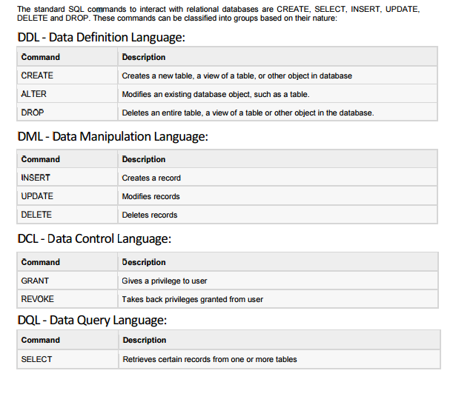
Sql Commands

Slide 52
Create table in database
create table emp(id number(10),name varchar2(40),age number(3));

Slide 53
Difference between varchar and varchar2
The oracle documentation says that VARCHAR is synonymous with VARCHAR2
1. VARCHAR is going to be replaced by VARCHAR2 in next version. So, Oracle suggests the use VARCHAR2 instead of VARCHAR while declaring datatype.
2. VARCHAR can store up to 2000 bytes of characters while VARCHAR2 can store up to 4000 bytes of characters.
3. If we declare datatype as VARCHAR then it will occupy space for NULL values, In case of VARCHAR2 datatype it will not occupy any space
Reference: http://download.oracle.com/docs/cd/B19306_01/server.102/b14200/sql_elements001.htm#sthref79

Slide 54
Note
To connect java application with the Oracle database ojdbc14.jar or ojdbc6.jar file is required to be loaded.

Slide 55
Two ways to load the jar file:
paste the ojdbc14.jar file in jre/lib/ext folder
set classpath

Slide 56
Oracle jar file is available in oracle installation directory
Ex path:
C:\oraclexe\app\oracle\product\11.2.0\server\jdbc\lib

Slide 57
To find out oracle database global name
Select * from global_name;

Slide 58
Example to Connect Java Application with Oracle database
Class.forName("oracle.jdbc.driver.OracleDriver");
//step2 create the connection object
Connection con=DriverManager.getConnection(
"jdbc:oracle:thin:@localhost:1521:xe","system","oracle");
//step3 create the statement object
Statement stmt=con.createStatement();
//step4 execute query
ResultSet rs=stmt.executeQuery("select * from emp");
while(rs.next())
System.out.println(rs.getInt(1)+" "+rs.getString(2)+" "+rs.getString(3));
//step5 close the connection object
con.close();

Slide 59

Select * from query

Slide 60
Example to connect to the mysql database
Driver class: The driver class for the mysql database is com.mysql.jdbc.Driver.
Connection URL: The connection URL for the mysql database is jdbc:mysql://localhost:3306/mydb where jdbc is the API, mysql is the database, localhost is the server name on which mysql is running, we may also use IP address, 3306 is the port number and mydb is the database name. We may use any database, in such case, you need to replace the mydb with your database name.
Username: The default username for the mysql database is root.
Password: Password is given by the user at the time of installing the mysql database. In this example, we are going to use root as the password.

Slide 61
Create database and table
create database mydb;
use mydb;
create table emp(id int(10),name varchar(40),age int(3));

Slide 62
Note
To connect java application with the mysql database mysqlconnector.jar file is required to be loaded.

Slide 63
Example to Connect Java Application with Mysql database
Class.forName("com.mysql.jdbc.Driver");
Connection con=DriverManager.getConnection(
"jdbc:mysql://localhost:3306/mydb","root","root");
//here mydb is database name, root is username and password
Statement stmt=con.createStatement();
ResultSet rs=stmt.executeQuery("select * from emp");
while(rs.next())
System.out.println(rs.getInt(1)+" "+rs.getString(2)+" "+rs.getString(3));
con.close();

Slide 64
Note
Java is mostly used with Oracle, mysql, or DB2 database. So you can learn this topic only for knowledge.

Slide 65
Create database in MSAccess
Create the login table in the access database. There is only one column in the table named name.

Slide 66
Note: ClassNotFoundException – sun.jdbc.odbc.JdbcOdbcDriver
in JDK 8, jdbc odbc bridge is no longer used and thus removed fro the JDK. to use Microsoft Access database in JAVA, you need 5 extra JAR libraries.
UCanAccess jars work for JDK7 and below versions also.
Download UCanAccess 2.0.8 zip file, which has all below jars
1- hsqldb.jar
2- jackcess 2.0.4.jar
3- commons-lang-2.6.jar
4- commons-logging-1.1.1.jar
5- ucanaccess-2.0.8.jar – Add this jar also
Connection conn=DriverManager.getConnection("jdbc:ucanaccess://<Path to your database i.e. MS Access DB>");
Statement s = conn.createStatement();

Slide 67
MS ACCESS Connectivity with jdbc
1. download ucanaccess.rar and extract it
2. load the all the jars
Without IDE
1. set the class path (or)
2. copy/paste the jars in jre/ext lib folder
WithIDE
1. add the external jars to the build path
3. make sure your db file with extension .accdb if not make it as
4. ignore the Class.forName("sun.jdbc.odbc.JdbcOdbcDriver"); //no use anymore
5. add "jdbc:ucanaccess://path\\emp.accdb" of db as your url pattern

Slide 68
Example to connect with MS ACCESS DB using UCANACCESS concept
public class JDBCAppMSAccess {
public static void main(String[] args) throws ClassNotFoundException, SQLException {
String url="jdbc:ucanaccess://EMP.accdb";
Connection conn = DriverManager.getConnection(url);
Statement statement = conn.createStatement();
String sql = "select * from emp";
ResultSet resultSet = statement.executeQuery(sql);
System.out.println("EMPID NAME AGE");
while(resultSet.next()){
System.out.println(resultSet.getInt(1)+" "+resultSet.getString(2)+" "+resultSet.getInt(3));
}
conn.close();
} }

Slide 69
ResultSet interface
The object of ResultSet maintains a cursor pointing to a particular row of data. Initially, cursor points to before the first row.
By default, ResultSet object can be moved forward only and it is not updatable.
But we can make this object to move forward and backward direction by passing either TYPE_SCROLL_INSENSITIVE or TYPE_SCROLL_SENSITIVE in createStatement(int,int) method as well as we can make this object as updatable by:
Statement stmt = con.createStatement(ResultSet.TYPE_SCROLL_INSENSITIVE, ResultSet.CONCUR_UPDATABLE);

Slide 70
What are different types of ResultSet?
There are three types of ResultSet object.
ResultSet.TYPE_FORWARD_ONLY: This is the default type and cursor can only move forward in the result set.
ResultSet.TYPE_SCROLL_INSENSITIVE: The cursor can move forward and backward, and the result set is not sensitive to changes made by others to the database after the result set was created.
ResultSet.TYPE_SCROLL_SENSITIVE: The cursor can move forward and backward, and the result set is sensitive to changes made by others to the database after the result set was created.
Based on the concurrency there are two types of ResultSet object.
ResultSet.CONCUR_READ_ONLY: The result set is read only, this is the default concurrency type.
ResultSet.CONCUR_UPDATABLE: We can use ResultSet update method to update the rows data.

Slide 71
Commonly used methods of ResultSet interface
1) public boolean next(): | is used to move the cursor to the one row next from the current position.
2) public boolean previous(): | is used to move the cursor to the one row previous from the current position.
3) public boolean first(): | is used to move the cursor to the first row in result set object.
4) public boolean last(): | is used to move the cursor to the last row in result set object.
5) public boolean absolute(int row): | is used to move the cursor to the specified row number in the ResultSet object.
6) public boolean relative(int row): | is used to move the cursor to the relative row number in the ResultSet object, it may be positive or negative.
7) public int getInt(int columnIndex): | is used to return the data of specified column index of the current row as int.
8) public int getInt(String columnName): | is used to return the data of specified column name of the current row as int.
9) public String getString(int columnIndex): | is used to return the data of specified column index of the current row as String.
10) public String getString(String columnName): | is used to return the data of specified column name of the current row as String.

Slide 72
Example of Scrollable ResultSet ResultSet interface to retrieve the data of 3rd row.
Class.forName("oracle.jdbc.driver.OracleDriver");
Connection con=DriverManager.getConnection("jdbc:oracle:thin:@localhost:1521:xe","system","oracle");
Statement stmt=con.createStatement(ResultSet.TYPE_SCROLL_SENSITIVE,ResultSet.CONCUR_UPDATABLE);
ResultSet rs=stmt.executeQuery("select * from emp765");
//getting the record of 3rd row
rs.absolute(3);
System.out.println(rs.getString(1)+" "+rs.getString(2)+" "+rs.getString(3));
con.close();

Slide 73
What is the use of setFetchSize() and setMaxRows() methods in Statement?
We can use setMaxRows(int i) method to limit the number of rows that the database returns from the query. You can achieve the same thing using SQL query itself.
For example in MySQL we can use LIMIT clause to set the max rows that will be returned by the query.
Understanding fetchSize can be tricky, for that you should know how Statement and ResultSet works. When we execute a query in the database, the result is obtained and maintained in the database cache and ResultSet is returned. ResultSet is the cursor that has the reference to the result in the database.
Let’s say we have a query that returns 100 rows and we have set fetchSize to 10, so in every database trip JDBC driver will fetch only 10 rows and hence there will be 10 trips to fetch all the rows. Setting optimal fetchSize is helpful when you need a lot of processing time for each row and number of rows in the result is huge.
We can set fetchSize through Statement object but it can be overridden through ResultSet object setFetchSize() method.

Slide 74
PreparedStatement interface
The PreparedStatement interface is a subinterface of Statement. It is used to execute parameterized query.
Parameterized query:
String sql="insert into emp values(?,?,?)";
we are passing parameter (?) for the values. Its value will be set by calling the setter methods of PreparedStatement.

Slide 75
Why use PreparedStatement?
Improves performance: The performance of the application will be faster if you use PreparedStatement interface because query is compiled only once.
PreparedStatement helps us in preventing SQL injection attacks because it automatically escapes the special characters.

Slide 76
How to get the instance of PreparedStatement?
public PreparedStatement prepareStatement(String query)throws SQLException{}

Slide 77
Methods of PreparedStatement interface
Method | Description
public void setInt(int paramIndex, int value) | sets the integer value to the given parameter index.
public void setString(int paramIndex, String value) | sets the String value to the given parameter index.
public void setFloat(int paramIndex, float value) | sets the float value to the given parameter index.
public void setDouble(int paramIndex, double value) | sets the double value to the given parameter index.
public int executeUpdate() | executes the query. It is used for create, drop, insert, update, delete etc.
public ResultSet executeQuery() | executes the select query. It returns an instance of ResultSet.

Slide 78
Example of PreparedStatement interface that inserts the record

Slide 79
Create emp table
create table emp(id number(10),name varchar2(50));

Slide 80
Java Program
Class.forName("oracle.jdbc.driver.OracleDriver");
Connection con=DriverManager.getConnection("jdbc:oracle:thin:@localhost:1521:xe","system","oracle");
PreparedStatement stmt=con.prepareStatement("insert into Emp values(?,?)");
stmt.setInt(1,101);//1 specifies the first parameter in the query
stmt.setString(2,"Ratan");
int i=stmt.executeUpdate();
System.out.println(i+" records inserted");
con.close();

Slide 81
Example of PreparedStatement interface that updates the record
PreparedStatement stmt=con.prepareStatement("update emp set name=? where id=?");
stmt.setString(1,“Mangarao");//1 specifies the first parameter in the query i.e. name
stmt.setInt(2,101);
int i=stmt.executeUpdate();
System.out.println(i+" records updated");

Slide 82
Example of PreparedStatement interface that deletes the record
PreparedStatement stmt=con.prepareStatement("delete from emp where id=?");
stmt.setInt(1,101);
int i=stmt.executeUpdate();
System.out.println(i+" records deleted");

Slide 83
Example of PreparedStatement interface that retrieve the records of a table
PreparedStatement stmt=con.prepareStatement("select * from emp");
ResultSet rs=stmt.executeQuery();
while(rs.next()){
System.out.println(rs.getInt(1)+" "+rs.getString(2));
}

Slide 84
Example of PreparedStatement to insert records until user press n
do{
System.out.println("enter id:");
int id=Integer.parseInt(br.readLine());
System.out.println("enter name:");
String name=br.readLine();
System.out.println("enter salary:");
float salary=Float.parseFloat(br.readLine());
ps.setInt(1,id);
ps.setString(2,name);
ps.setFloat(3,salary);
int i=ps.executeUpdate();
System.out.println(i+" records affected");
System.out.println("Do you want to continue: y/n");
String s=br.readLine();
if(s.startsWith("n")){
break;
}
}while(true);

Slide 85
ResultSetMetaData Interface
The metadata means data about data i.e. we can get further information from the data.
If you have to get metadata of a table like total number of column, column name, column type etc. , ResultSetMetaData interface is useful because it provides methods to get metadata from the ResultSet object.

Slide 86
Commonly used methods of ResultSetMetaData interface
Method | Description
public int getColumnCount()throws SQLException | it returns the total number of columns in the ResultSet object.
public String getColumnName(int index)throws SQLException | it returns the column name of the specified column index.
public String getColumnTypeName(int index)throws SQLException | it returns the column type name for the specified index.
public String getTableName(int index)throws SQLException | it returns the table name for the specified column index.

Slide 87
How to get the object of ResultSetMetaData:
The getMetaData() method of ResultSet interface returns the object of ResultSetMetaData
public ResultSetMetaData getMetaData()throws SQLException

Slide 88
Example of ResultSetMetaData interface
Class.forName("oracle.jdbc.driver.OracleDriver");
Connection con=DriverManager.getConnection(
"jdbc:oracle:thin:@localhost:1521:xe","system","oracle");
String sqlQuery = “select * from emp”;
//String sqlQuery = “select id, name from emp”;
PreparedStatement ps=con.prepareStatement("select * from emp");
ResultSet rs=ps.executeQuery();
ResultSetMetaData rsmd=rs.getMetaData();
System.out.println("Total columns: "+rsmd.getColumnCount());
System.out.println("Column Name of 1st column: "+rsmd.getColumnName(1));
System.out.println("Column Type Name of 1st column: "+rsmd.getColumnTypeName(1));

Slide 89
DatabaseMetaData interface:
DatabaseMetaData interface provides methods to get meta data of a database such as database product name, database product version, driver name, name of total number of tables, name of total number of views etc

Slide 90
Commonly used methods of DatabaseMetaData interface
public String getDriverName()throws SQLException: it returns the name of the JDBC driver.
public String getDriverVersion()throws SQLException: it returns the version number of the JDBC driver.
public String getUserName()throws SQLException: it returns the username of the database.
public String getDatabaseProductName()throws SQLException: it returns the product name of the database.
public String getDatabaseProductVersion()throws SQLException: it returns the product version of the database.
public ResultSet getTables(String catalog, String schemaPattern, String tableNamePattern, String[] types)throws SQLException: it returns the description of the tables of the specified catalog. The table type can be TABLE, VIEW, ALIAS, SYSTEM TABLE, SYNONYM etc.

Slide 91
How to get the object of DatabaseMetaData:
The getMetaData() method of Connection interface returns the object of DatabaseMetaData.
Syntax:
public DatabaseMetaData getMetaData()throws SQLException

Slide 92
Simple Example of DatabaseMetaData interface :
Class.forName("oracle.jdbc.driver.OracleDriver");
Connection con=DriverManager.getConnection(
"jdbc:oracle:thin:@localhost:1521:xe","system","oracle");
DatabaseMetaData dbmd=con.getMetaData();
System.out.println("Driver Name: "+dbmd.getDriverName());
System.out.println("Driver Version: "+dbmd.getDriverVersion());
System.out.println("UserName: "+dbmd.getUserName());
System.out.println("Database Product Name: "+dbmd.getDatabaseProductName());
System.out.println("Database Product Version: "+dbmd.getDatabaseProductVersion());

Slide 93
Example of DatabaseMetaData interface that prints total number of tables
Class.forName("oracle.jdbc.driver.OracleDriver");
Connection con=DriverManager.getConnection(
"jdbc:oracle:thin:@localhost:1521:xe","system","oracle");
DatabaseMetaData dbmd=con.getMetaData();
String table[]={"TABLE"};
ResultSet rs=dbmd.getTables(null,null,null,table);
while(rs.next()){
System.out.println(rs.getString(3));
}

Slide 94
Example of DatabaseMetaData interface that prints total number of views :
Class.forName("oracle.jdbc.driver.OracleDriver");
Connection con=DriverManager.getConnection(
"jdbc:oracle:thin:@localhost:1521:xe","system","oracle");
DatabaseMetaData dbmd=con.getMetaData();
String table[]={"VIEW"};
ResultSet rs=dbmd.getTables(null,null,null,table);
while(rs.next()){
System.out.println(rs.getString(3));
}

Slide 95
Example to Store Image in Oracle Database
We can store images in the database in java by the help of PreparedStatement interface.
The setBinaryStream() method of PreparedStatement is used to set Binary information into the parameterIndex.

Slide 96
Signature of setBinaryStream method
1) public void setBinaryStream(int paramIndex,InputStream stream)
throws SQLException
2) public void setBinaryStream(int paramIndex,InputStream stream,long length)
throws SQLException

Slide 97
For storing image into the database, BLOB (Binary Large Object) datatype is used in the table.
CREATE TABLE "IMGTABLE"
( "NAME" VARCHAR2(4000),
"PHOTO" BLOB
)
/

Slide 98
JDBC Program
Class.forName("oracle.jdbc.driver.OracleDriver");
Connection con=DriverManager.getConnection(
"jdbc:oracle:thin:@localhost:1521:xe","system","oracle");
PreparedStatement ps=con.prepareStatement("insert into imgtable values(?,?)");
ps.setString(1,“mangarao");
FileInputStream fin=new FileInputStream("d:\\g.jpg");
ps.setBinaryStream(2,fin,fin.available());
int i=ps.executeUpdate();
System.out.println(i+" records affected")

Slide 99
Note
Database Query: Select * from IMGTABLE;
If you see the table, record is stored in the database but image will not be shown. To do so, you need to retrieve the image from the database.

Slide 100
Example to retrieve image from Oracle database
By the help of PreparedStatement we can retrieve and store the image in the database.
The getBlob() method of PreparedStatement is used to get Binary information, it returns the instance of Blob. After calling the getBytes() method on the blob object, we can get the array of binary information that can be written into the image file.

Slide 101
getBlob() method signature
public Blob getBlob()throws SQLException

Slide 102
Signature of getBytes() method of Blob interface
public byte[] getBytes(long pos, int length)throws SQLException

Slide 103
JDBC Code
Class.forName("oracle.jdbc.driver.OracleDriver");
Connection con=DriverManager.getConnection(
"jdbc:oracle:thin:@localhost:1521:xe","system","oracle");
PreparedStatement ps=con.prepareStatement("select * from imgtable");
ResultSet rs=ps.executeQuery();
if(rs.next()){//now on 1st row
Blob b=rs.getBlob(2);//2 means 2nd column data
byte barr[]=b.getBytes(1,(int)b.length());//1 means first image
FileOutputStream fout=new FileOutputStream("d:\\javalogo.jpg");
fout.write(barr);

Slide 104
Example to store file in Oracle database:
The setCharacterStream() method of PreparedStatement is used to set character information into the parameterIndex.

Slide 105
Syntax:
1) public void setCharacterStream(int paramIndex,InputStream stream)throws SQLException
2) public void setCharacterStream(int paramIndex,InputStream stream,long length)throws SQLException

Slide 106
For storing file into the database, CLOB (Character Large Object) datatype is used in the table
CREATE TABLE "FILETABLE"
( "ID" NUMBER,
"NAME" CLOB
)

Slide 107
JDBC Code
Class.forName("oracle.jdbc.driver.OracleDriver");
Connection con=DriverManager.getConnection(
"jdbc:oracle:thin:@localhost:1521:xe","system","oracle");
PreparedStatement ps=con.prepareStatement(
"insert into filetable values(?,?)");
File f=new File("d:\\myfile.txt");
FileReader fr=new FileReader(f);
ps.setInt(1,101);
ps.setCharacterStream(2,fr,(int)f.length());
int i=ps.executeUpdate();
System.out.println(i+" records affected");

Slide 108
Example to retrieve file from Oracle database:
The getClob() method of PreparedStatement is used to get file information from the database.

Slide 109
Syntax of getClob() method
public Clob getClob(int columnIndex){}

Slide 110
JDBC Code
Class.forName("oracle.jdbc.driver.OracleDriver");
Connection con=DriverManager.getConnection(
"jdbc:oracle:thin:@localhost:1521:xe","system","oracle");
PreparedStatement ps=con.prepareStatement("select * from filetable");
ResultSet rs=ps.executeQuery();
rs.next();//now on 1st row
Clob c=rs.getClob(2);
Reader r=c.getCharacterStream();
FileWriter fw=new FileWriter("d:\\retrivefile.txt");
int i;
while((i=r.read())!=-1)
fw.write((char)i);

Slide 111
CallableStatement Interface
To call the stored procedures and functions, CallableStatement interface is used.
We can have business logic on the database by the use of stored procedures and functions that will make the performance better because these are precompiled.
Suppose you need the get the age of the employee based on the date of birth, you may create a function that receives date as the input and returns age of the employee as the output.

Slide 112
What is the difference between stored procedures and functions.
Stored Procedure | Function
is used to perform business logic. | is used to perform calculation.
must not have the return type. | must have the return type.
may return 0 or more values. | may return only one values.
We can call functions from the procedure. | Procedure cannot be called from function.
Procedure supports input and output parameters. | Function supports only input parameter.
Exception handling using try/catch block can be used in stored procedures. | Exception handling using try/catch can't be used in user defined functions.

Slide 113
How to get the instance of CallableStatement?
The prepareCall() method of Connection interface returns the instance of CallableStatement
public CallableStatement prepareCall("{ call procedurename(?,?...?)}");
Ex:
CallableStatement stmt=con.prepareCall("{call myprocedure(?,?)}");

Slide 114
Table and stored procedure creation
create table user420(id number(10), name varchar2(200));
create or replace procedure "INSERTR"
(id IN NUMBER,
name IN VARCHAR2)
is
begin
insert into user420 values(id,name);
end;

Slide 115
JDBC Code
Class.forName("oracle.jdbc.driver.OracleDriver");
Connection con=DriverManager.getConnection(
"jdbc:oracle:thin:@localhost:1521:xe","system","oracle");
CallableStatement stmt=con.prepareCall("{call insertR(?,?)}");
stmt.setInt(1,1011);
stmt.setString(2,"Amit");
stmt.execute();
System.out.println("success");

Slide 116
Example to call the function using JDBC
In this example, we are calling the sum4 function that receives two input and returns the sum of the given number. Here, we have used the registerOutParametermethod of CallableStatement interface, that registers the output parameter with its corresponding type. It provides information to the CallableStatement about the type of result being displayed
The Types class defines many constants such as INTEGER, VARCHAR, FLOAT, DOUBLE, BLOB, CLOB etc.

Slide 117
Create Simple function
create or replace function get_sum
(n1 in number,n2 in number)
return number
is
temp number;
begin
temp :=n1+n2;
return temp;
end;

Slide 118
Note
Don’t create user function name with sum.
Sum() is a predefined function in oracle database.

Slide 119
JDBC code
Class.forName("oracle.jdbc.driver.OracleDriver");
Connection con=DriverManager.getConnection(
"jdbc:oracle:thin:@localhost:1521:xe","system","oracle");
CallableStatement stmt=con.prepareCall("{?= call sum4(?,?)}");
stmt.setInt(2,10);
stmt.setInt(3,43);
stmt.registerOutParameter(1,Types.INTEGER);
stmt.execute();
System.out.println(stmt.getInt(1));

Slide 120
Example to call procedure, which returns values
create or replace procedure getEmpDetails(
id in number,
name out varchar2,
salary out number)
is
begin
select ename, sal into name,salary from emp where eid=id;
end;
/

Slide 121
JDBC Program to call procedure
// Step 1 - Register the driver
Class.forName("oracle.jdbc.driver.OracleDriver");
// Step 2 - Create a connection
Connection conn = DriverManager.getConnection("jdbc:oracle:thin:@localhost:1521:XE", "system", "manager");
System.out.println("Connection is created successfully");
// Step 3 - create Statement object
CallableStatement cstmt = conn.prepareCall("{call getEmpDetails(?,?,?)}");
cstmt.setInt(1, 101);
cstmt.registerOutParameter(2, Types.VARCHAR);
cstmt.registerOutParameter(3, Types.INTEGER);
cstmt.execute();
System.out.println("EMP NAME: "+cstmt.getString(2)+" sal: "+cstmt.getInt(3));
conn.close();

Slide 122
JDBC code
Class.forName("oracle.jdbc.driver.OracleDriver");
Connection con=DriverManager.getConnection(
"jdbc:oracle:thin:@localhost:1521:xe","system","oracle");
CallableStatement stmt=con.prepareCall("{?= call sum4(?,?)}");
stmt.setInt(2,10);
stmt.setInt(3,43);
stmt.registerOutParameter(1,Types.INTEGER);
stmt.execute();
System.out.println(stmt.getInt(1));

Slide 123
Transaction Management in JDBC
Transaction represents a single unit of work.
The ACID properties describes the transaction management well. ACID stands for Atomicity, Consistency, isolation and durability.
Atomicity means either all successful or none.
Consistency ensures bringing the database from one consistent state to another consistent state.
Isolation ensures that transaction is isolated from other transaction.
Durability means once a transaction has been committed, it will remain so, even in the event of errors, power loss etc.

Slide 124
Advantage of Transaction Mangaement
fast performance It makes the performance fast because database is hit at the time of commit.

Slide 125
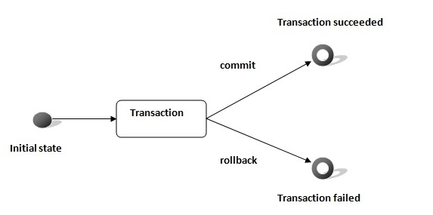

Slide 126
Connection interface provides methods to manage transaction.
Method | Description
void setAutoCommit(boolean status) | It is true bydefault means each transaction is committed bydefault.
void commit() | commits the transaction.
void rollback() | cancels the transaction.

Slide 127
Simple example of transaction management in jdbc using Statement
Class.forName("oracle.jdbc.driver.OracleDriver");
Connection con=DriverManager.getConnection("jdbc:oracle:thin:@localhost:1521:xe","system","oracle");
con.setAutoCommit(false);
Statement stmt=con.createStatement();
stmt.executeUpdate("insert into user420 values(190,'abhi',40000)");
stmt.executeUpdate("insert into user420 values(191,'umesh',50000)");
con.commit();

Slide 128
Batch Processing in JDBC
Instead of executing a single query, we can execute a batch (group) of queries. It makes the performance fast.
The java.sql.Statement and java.sql.PreparedStatement interfaces provide methods for batch processing

Slide 129
Advantage of Batch Processing
Fast Performance

Slide 130
Methods of Statement interface
Method | Description
void addBatch(String query) | It adds query into batch.
int[] executeBatch() | It executes the batch of queries.

Slide 131
batch processing in jdbc
Load the driver class
Create Connection
Create Statement
Add query in the batch
Execute Batch
Close Connection

Slide 132
Example
Class.forName("oracle.jdbc.driver.OracleDriver");
Connection con=DriverManager.getConnection("jdbc:oracle:thin:@localhost:1521:xe","system","oracle");
con.setAutoCommit(false);
Statement stmt=con.createStatement();
stmt.addBatch("insert into user420 values(190,'abhi',40000)");
stmt.addBatch("insert into user420 values(191,'umesh',50000)");
stmt.executeBatch();//executing the batch
con.commit();

Slide 133
Example of batch processing using PreparedStatement
PreparedStatement ps=con.prepareStatement("insert into user420 values(?,?,?)");
ps.setInt(1,101);
ps.setString(2,”JOHN”);
ps.setInt(3,2000);
ps.addBatch();
ps.setInt(1,102);
ps.setString(2,”Zach”);
ps.setInt(3,3000);
ps.addBatch();
ps.executeBatch();
System.out.println("record successfully saved");

Slide 134
JDBC RowSet
The instance of RowSet is the java bean component because it has properties and java bean notification mechanism. It is introduced since JDK 5.
It is the wrapper of ResultSet. It holds tabular data like ResultSet but it is easy and flexible to use.

Slide 135
The implementation classes of RowSet interface are as follows:
JdbcRowSet
CachedRowSet
WebRowSet
JoinRowSet
FilteredRowSet

Slide 136
how to create and execute RowSet
JdbcRowSet rowSet = RowSetProvider.newFactory().createJdbcRowSet();
rowSet.setUrl("jdbc:oracle:thin:@localhost:1521:xe");
rowSet.setUsername("system");
rowSet.setPassword("oracle");
rowSet.setCommand("select * from emp400");
rowSet.execute();
It is the new way to get the instance of JdbcRowSet since JDK 7.

Slide 137
Advantage of RowSet
It is easy and flexible to use
It is Scrollable and Updatable bydefault

Slide 138
Simple example of JdbcRowSet
Class.forName("oracle.jdbc.driver.OracleDriver");
//Creating and Executing RowSet
JdbcRowSet rowSet = RowSetProvider.newFactory().createJdbcRowSet();
rowSet.setUrl("jdbc:oracle:thin:@localhost:1521:xe");
rowSet.setUsername("system");
rowSet.setPassword("oracle");
rowSet.setCommand("select * from emp400");
rowSet.execute();
while (rowSet.next()) {
// Generating cursor Moved event
System.out.println("Id: " + rowSet.getString(1));
System.out.println("Name: " + rowSet.getString(2));
System.out.println("Salary: " + rowSet.getString(3));
}

Slide 139
Full example of Jdbc RowSet with event handling
To perform event handling with JdbcRowSet, you need to add the instance of RowSetListener in the addRowSetListener method of JdbcRowSet.

Slide 140
The RowSetListener interface provides 3 method that must be implemented. They are as follows:
1) public void cursorMoved(RowSetEvent event);
2) public void rowChanged(RowSetEvent event);
3) public void rowSetChanged(RowSetEvent event);

Slide 141
Note
The event handling operation can't be performed using ResultSet so it is preferred now.

Slide 142
Let's write the code to retrieve the data and perform some additional tasks while cursor is moved, cursor is changed or rowset is changed
class MyListener implements RowSetListener {
public void cursorMoved(RowSetEvent event) {
System.out.println("Cursor Moved...");
}
public void rowChanged(RowSetEvent event) {
System.out.println("Cursor Changed...");
}
public void rowSetChanged(RowSetEvent event) {
System.out.println("RowSet changed...");
}
}

Slide 143
RowSetExample
Class.forName("oracle.jdbc.driver.OracleDriver");
//Creating and Executing RowSet
JdbcRowSet rowSet = RowSetProvider.newFactory().createJdbcRowSet();
rowSet.setUrl("jdbc:oracle:thin:@localhost:1521:xe");
rowSet.setUsername("system");
rowSet.setPassword("oracle");
rowSet.setCommand("select * from emp400");
rowSet.execute();
//Adding Listener and moving RowSet
rowSet.addRowSetListener(new MyListener());
while (rowSet.next()) {
// Generating cursor Moved event
System.out.println("Id: " + rowSet.getString(1));
System.out.println("Name: " + rowSet.getString(2));
System.out.println("Salary: " + rowSet.getString(3));
}

Slide 144
What is the different between ResultSet and RowSet?
RowSet objects are derived from ResultSet, so they have all the features of ResultSet with some additional features. One of the huge benefit of RowSet is that they can be disconnected and that makes it lightweight and easy to transfer over a network.
Whether to use ResultSet or RowSet depends on your requirements but if you are planning to use ResultSet for longer duration, then a disconnected RowSet is better choice to free database resources.

Slide 145
What is JDBC DataSource and what are it’s benefits?
We have already seen that JDBC DriverManager can be used to get relational database connections. But when it comes to actual programming, we want more than just connections.
Most of the times we are looking for loose coupling for connectivity so that we can switch databases easily, connection pooling for transaction management and distributed systems support.
JDBC DataSource is the preferred approach if you are looking for any of these features in your application.
DataSource interface is present in javax.sql package and it only declare two overloaded methods getConnection() and getConnection(String str1,String str2).

Slide 146
It is the responsibility of different Database vendors to provide different kinds of implementation of DataSource interface. For example MySQL JDBC Driver provides basic implementation of DataSource interface with com.mysql.jdbc.jdbc2.optional.MysqlDataSource class and Oracle database driver implements it with oracle.jdbc.pool.OracleDataSource class.
These implementation classes provide methods through which we can provide database server details with user credentials.
Some of the other common features provided by these JDBC DataSource implementation classes are;
Caching of PreparedStatement for faster processing
Connection timeout settings
Logging features
ResultSet maximum size threshold
Connection Pooling in servlet container using JNDI support

Slide 147
JDBC DataSource Example
Let’s se how to use MySQL and Oracle DataSource basic implementation classes to get the database connection.

Slide 148
Database setup
--MySql:
CREATE TABLE `Employee` (
`empId` int(10) unsigned NOT NULL,
`name` varchar(10) DEFAULT NULL,
PRIMARY KEY (`empId`)
)
-- insert some sample data
INSERT INTO `Employee` (`empId`, `name`)
VALUES
(1, ‘AMR'),
(2, ‘NTR');
commit;

Slide 149
-Oracle DB
CREATE TABLE "EMPLOYEE"
(
"EMPID" NUMBER NOT NULL ENABLE,
"NAME" VARCHAR2(10 BYTE) DEFAULT NULL,
PRIMARY KEY ("EMPID")
);
Insert into EMPLOYEE (EMPID,NAME) values (101,‘PJR');
Insert into EMPLOYEE (EMPID,NAME) values (102,‘KCR');
Insert into EMPLOYEE (EMPID,NAME) values (103,‘KTR');
commit;

Slide 150
db.properties file:
#mysql DB properties
MYSQL_DB_DRIVER_CLASS=com.mysql.jdbc.Driver
MYSQL_DB_URL=jdbc:mysql://localhost:3306/myDB
MYSQL_DB_USERNAME=root
MYSQL_DB_PASSWORD=root
#Oracle DB Properties
ORACLE_DB_DRIVER_CLASS=oracle.jdbc.driver.OracleDriver
ORACLE_DB_URL=jdbc:oracle:thin:@localhost:1521:xe
ORACLE_DB_USERNAME=system
ORACLE_DB_PASSWORD=manager

Slide 151
DataSource creation class

Slide 152
import javax.sql.DataSource;
import oracle.jdbc.pool.OracleDataSource;
import com.mysql.jdbc.jdbc2.optional.MysqlDataSource;
public class MyDataSourceFactory {
public static DataSource getMySQLDataSource() {
Properties props = new Properties();
FileInputStream fis = null;
MysqlDataSource mysqlDS = null;
try {
fis = new FileInputStream("db.properties");
props.load(fis);
mysqlDS = new MysqlDataSource();
mysqlDS.setURL(props.getProperty("MYSQL_DB_URL"));
mysqlDS.setUser(props.getProperty("MYSQL_DB_USERNAME"));
mysqlDS.setPassword(props.getProperty("MYSQL_DB_PASSWORD"));
} catch (IOException e) {
e.printStackTrace();
}
return mysqlDS;
}
//Continuation in next slide

Slide 153
public static DataSource getOracleDataSource(){
Properties props = new Properties();
FileInputStream fis = null;
OracleDataSource oracleDS = null;
try {
fis = new FileInputStream("db.properties");
props.load(fis);
oracleDS = new OracleDataSource();
oracleDS.setURL(props.getProperty("ORACLE_DB_URL"));
oracleDS.setUser(props.getProperty("ORACLE_DB_USERNAME"));
oracleDS.setPassword(props.getProperty("ORACLE_DB_PASSWORD"));
} catch (IOException e) {
e.printStackTrace();
} catch (SQLException e) {
e.printStackTrace();
}
return oracleDS;
}
}

Slide 154
public class DataSourceTest {
public static void main(String[] args) {
testDataSource("mysql");
System.out.println("**********");
testDataSource("oracle");
}
//Continuation is next slide

Slide 155
private static void testDataSource(String dbType) {
DataSource ds = null;
if("mysql".equals(dbType)){
ds = MyDataSourceFactory.getMySQLDataSource();
}else if("oracle".equals(dbType)){
ds = MyDataSourceFactory.getOracleDataSource();
}else{
System.out.println("invalid db type");
return;
}
Connection con = null; Statement stmt = null; ResultSet rs = null;
try {
con = ds.getConnection(); stmt = con.createStatement();
rs = stmt.executeQuery("select empid, name from Employee");
while(rs.next()){
System.out.println("Employee ID="+rs.getInt("empid")+", Name="+rs.getString("name"));
}
} catch (SQLException e) {
e.printStackTrace();
}finally{}
}}
}

Slide 156
Note
Notice that the client class is totally independent of any Database specific classes. This helps us in hiding the underlying implementation details from client program and achieve loose coupling and abstraction benefits.

Slide 157
Apache Commons DBCP Example
If you look at above Java DataSource factory class, there are two major issues with it.
The factory class methods to create the MySQL and Oracle DataSource are tightly coupled with respective driver API. If we want to remove support for Oracle database in future or want to add some other database support, it will require code change.
Most of the code to get the MySQL and Oracle DataSource is similar, the only different is the implementation class that we are using.
Apache Commons DBCP API helps us in getting rid of these issues by providing Java DataSource implementation that works as an abstraction layer between our program and different JDBC drivers.
Apache DBCP library depends on Commons Pool library, so make sure below two jars are in the build path.
commons-dbcp.jar
commons-pool.jar

Slide 158
import org.apache.commons.dbcp.BasicDataSource;
public class DBCPDataSourceFactory {
public static DataSource getDataSource(String dbType){
Properties props = new Properties(); FileInputStream fis = null; BasicDataSource ds = new BasicDataSource();
try {
fis = new FileInputStream("db.properties");
props.load(fis);
}catch(IOException e){
return null; }
if("mysql".equals(dbType)){
ds.setDriverClassName(props.getProperty("MYSQL_DB_DRIVER_CLASS"));
ds.setUrl(props.getProperty("MYSQL_DB_URL"));
ds.setUsername(props.getProperty("MYSQL_DB_USERNAME"));
ds.setPassword(props.getProperty("MYSQL_DB_PASSWORD"));
}else if("oracle".equals(dbType)){
ds.setDriverClassName(props.getProperty("ORACLE_DB_DRIVER_CLASS"));
ds.setUrl(props.getProperty("ORACLE_DB_URL"));
ds.setUsername(props.getProperty("ORACLE_DB_USERNAME"));
ds.setPassword(props.getProperty("ORACLE_DB_PASSWORD"));
}else{
return null;
}
return ds;
} }

Slide 159
Client Program
public class ApacheCommonsDBCPTest {
public static void main(String[] args) {
testDBCPDataSource("mysql");
System.out.println("**********");
testDBCPDataSource("oracle");
}
//Continuation in next slide

Slide 160
private static void testDBCPDataSource(String dbType) {
DataSource ds = DBCPDataSourceFactory.getDataSource(dbType);
Connection con = null; Statement stmt = null; ResultSet rs = null;
try {
con = ds.getConnection();
stmt = con.createStatement();
rs = stmt.executeQuery("select empid, name from Employee");
while(rs.next()){
System.out.println("Employee ID="+rs.getInt("empid")+", Name="+rs.getString("name"));
}
} catch (SQLException e) {
e.printStackTrace();
}
}

Slide 161
Notes
If you look at the Java JDBC DataSource and above usage, it can be done with normal DriverManager too. The major benefit of Java DataSource is when it’s used within a Context and with JNDI.
With simple configurations we can create a Database Connection Pool that is maintained by the Container itself. Most of the servlet containers such as Tomcat and JBoss provide it’s own Java DataSource implementation and all we need is to configure it through simple XML based configurations and then use JNDI context lookup to get the Java DataSource and work with it. This helps us by taking care of connection pooling and management from our application side to server side and thus giving us more time to write business logic for the application.

Slide 162
How to achieve JDBC Connection Pooling using JDBC DataSource and JNDI in Apache Tomcat Server?
For web applications deployed in a servlet container, creating JDBC connection pool is very easy and involve only few steps.
1. Creating JDBC JNDI resource in the container configuration files, usually server.xml or context.xml. For example

Slide 163
server.xml
<Resource name="jdbc/MyDB"
global="jdbc/MyDB"
auth="Container"
type="javax.sql.DataSource"
driverClassName="com.mysql.jdbc.Driver"
url="jdbc:mysql://localhost:3306/UserDB"
username="pankaj"
password="pankaj123"
maxActive="100"
maxIdle="20"
minIdle="5"
maxWait="10000"/>

Slide 164
context.xml
<ResourceLink name="jdbc/MyLocalDB"
global="jdbc/MyDB"
auth="Container"
type="javax.sql.DataSource" />

Slide 165
2. In web application, using InitialContext to look up the JNDI resource configured in the first step and then get the connection.
Context ctx = new InitialContext();
DataSource ds = (DataSource) ctx.lookup("java:/comp/env/jdbc/MyLocalDB");

Slide 166
What are JDBC Best Practices?
Database resources are heavy, so make sure you close it as soon as you are done with it.
Connection, Statement, ResultSet and all other JDBC objects have close() method defined to close them.
Always close the result set, statement and connection explicitly in the code, because if you are working in connection pooling environment, the connection might be returned to the pool leaving open result sets and statement objects resulting in resource leak.
Close the resources in the finally block to make sure they are closed even in case of exception scenarios.
Use batch processing for bulk operations of similar kind.
Always use PreparedStatement over Statement to avoid SQL Injection and get pre-compilation and caching benefits of PreparedStatement.
If you are retrieving bulk data into result set, setting an optimal value for fetchSize helps in getting good performance.
If you are creating database connections in a web application, try to use JDBC DataSource resources using JNDI context for re-using the connections.
Try to use disconnected RowSet when you need to work with ResultSet for a long time.

